Slide 1
Lesson 7:
Electronic devices based on nanostructures

Slide 2


Slide 3
Resonant tunneling diode
Heterojunction bipolar transistor
Inorganic nanoelectronics→
Single electron transistors
Nanowires and Nanotubes diodes
Graphene based transistor
Organic nanoelectronics→Molecular Electronics

Slide 4
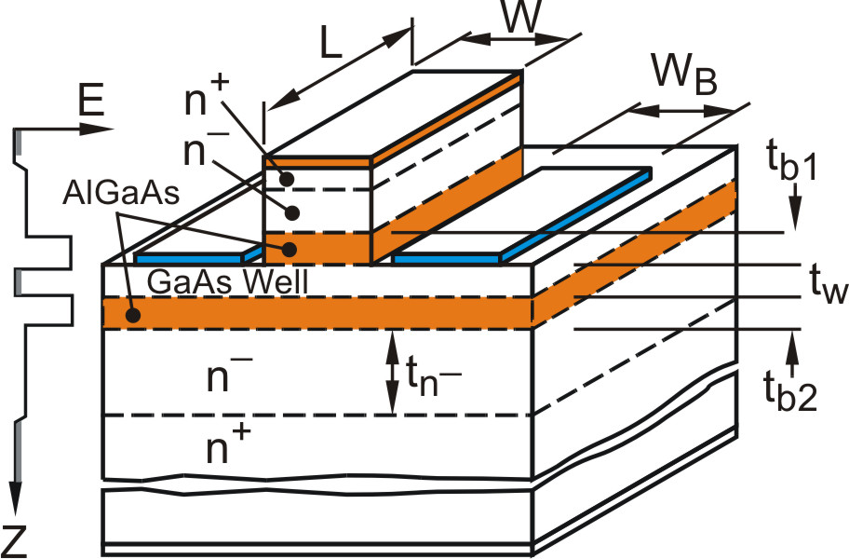
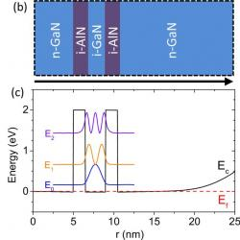
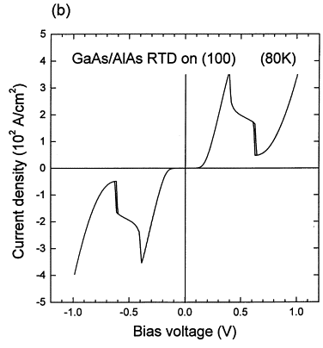
A) Resonant tunnelling diode

Slide 5
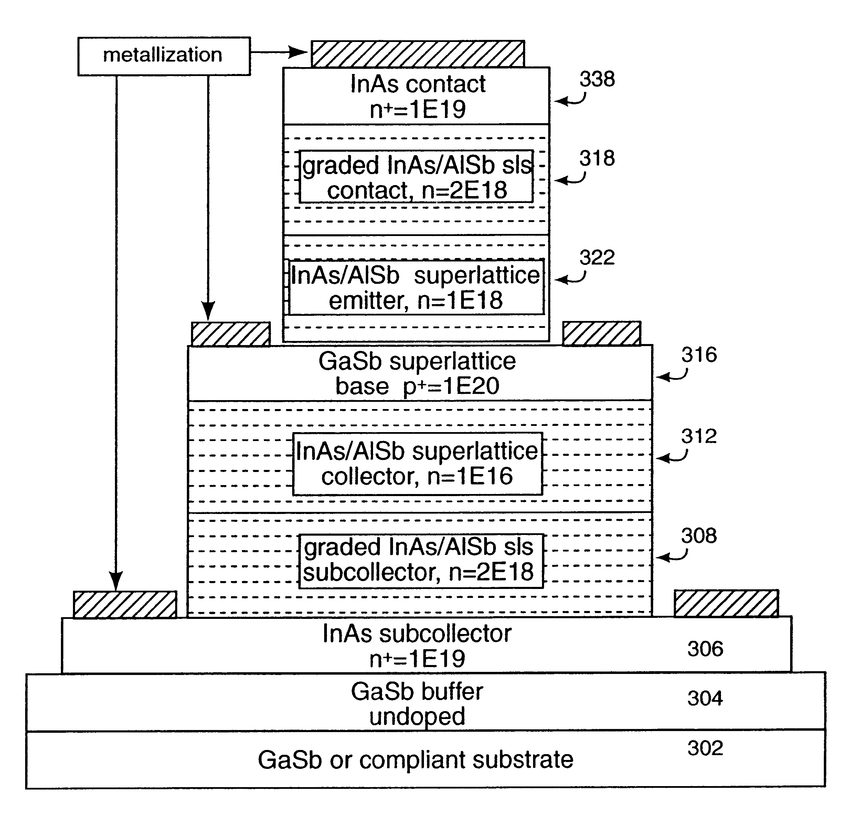
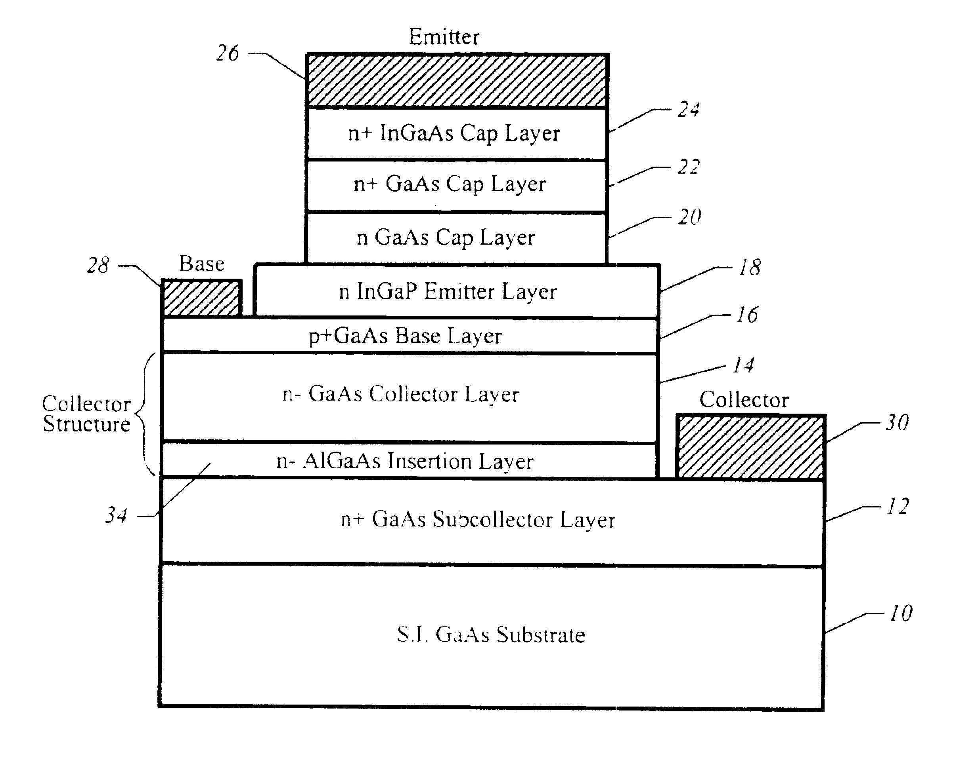
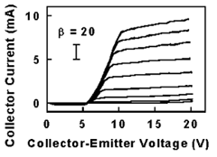
B) Heterojunction bipolar transistor

Slide 6
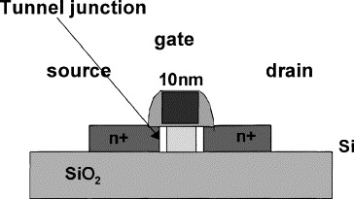
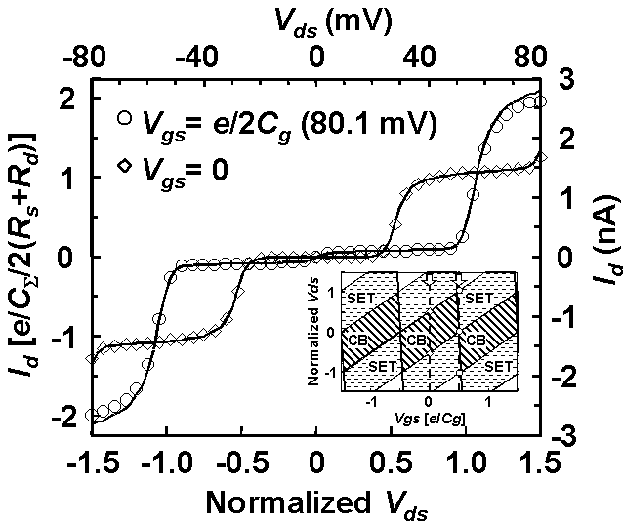
C) Single electron transistor

Slide 7
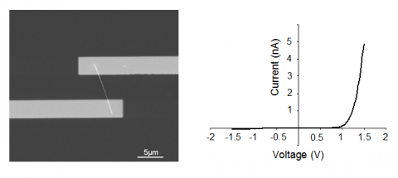
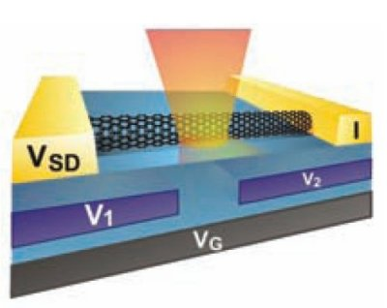
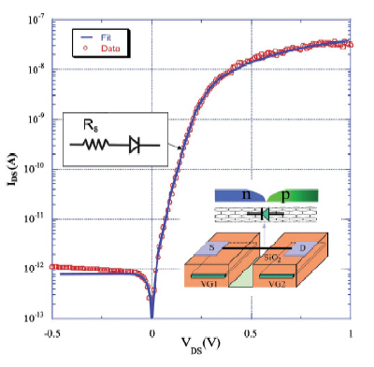
D) Nanowire diode

Slide 8
E) Molecular electronics (molecular diode)

Slide 9
What I avoided

Slide 10
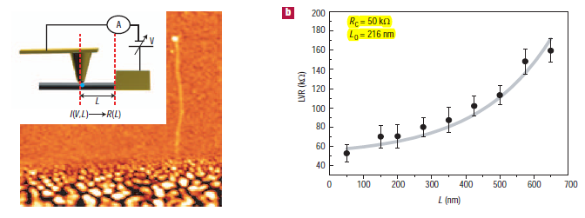

A) Localization effect (Anderson localization). Disordered systems

Slide 11
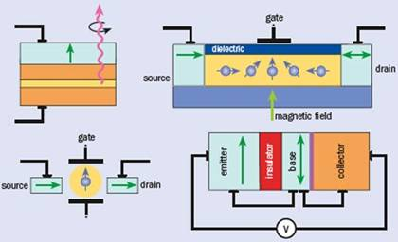
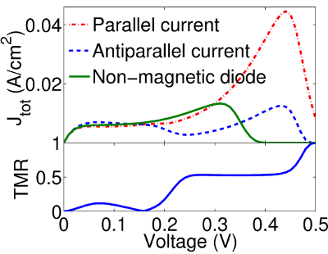
B) Spin related-effects (Spintronics)

Slide 12
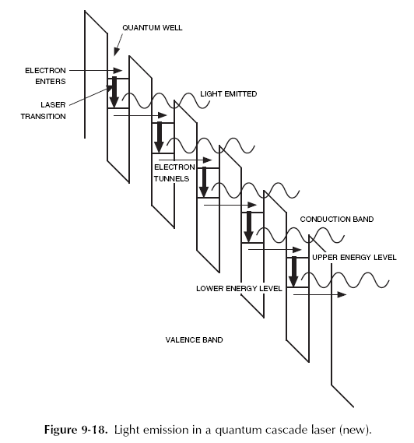
C) Low-dimensional systems optical properties (quantum cascade laser, …..)

