Slide 1
Lesson 5, Part 3:
Single electron effects: Coulomb blockade and staircase (Quantum Dots)

Slide 2
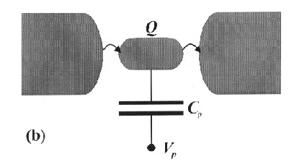
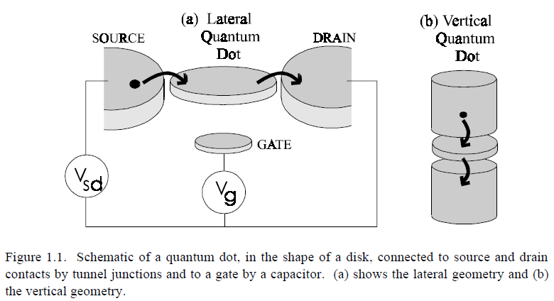

Slide 3
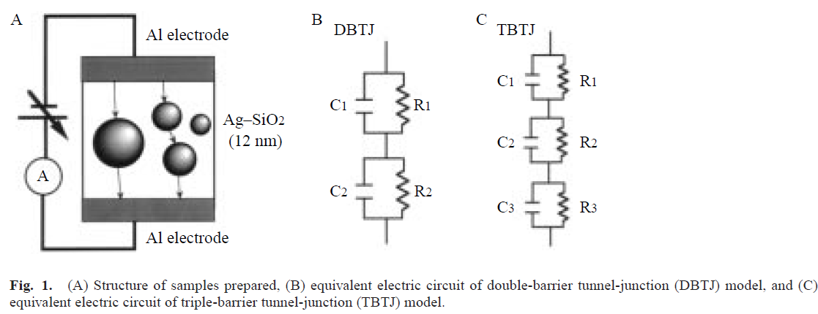
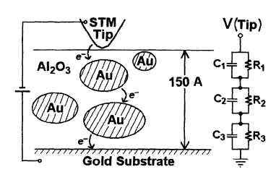
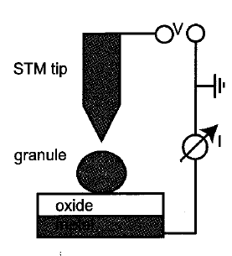
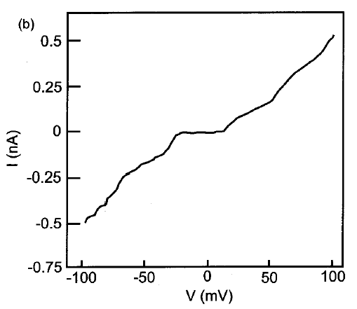
C
R

Slide 4
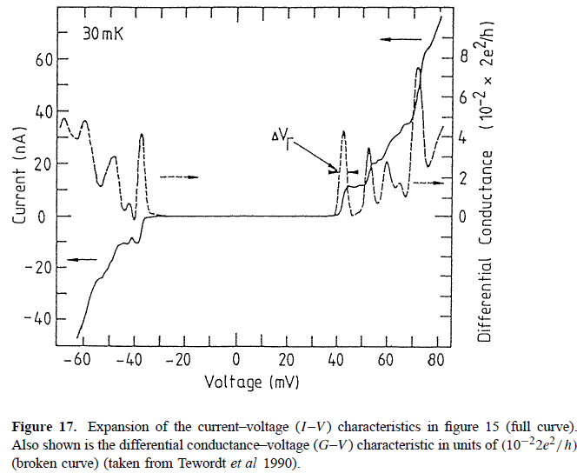
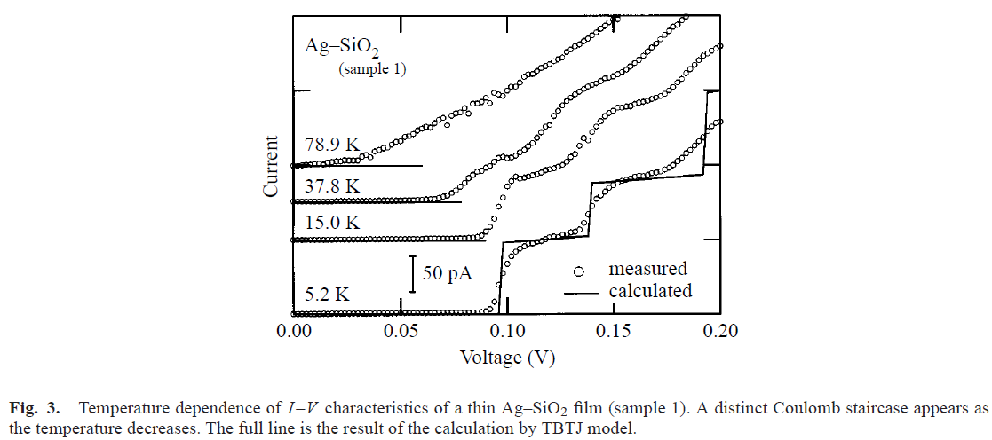
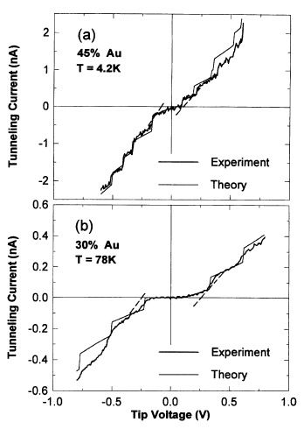
Coulomb blockade
Coulomb Staircase

Slide 5
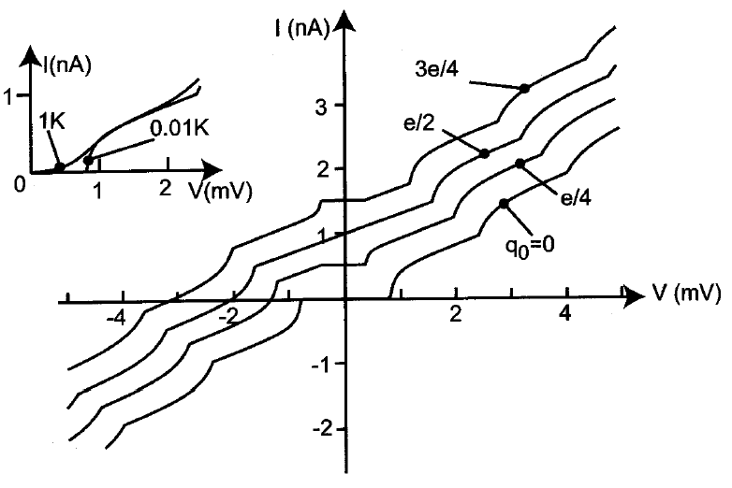
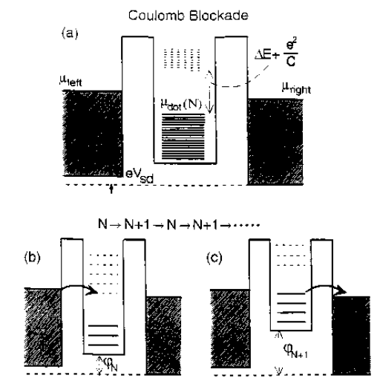
Thermal smearing
Coulomb staircase

Slide 6
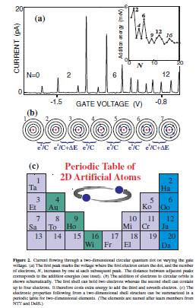
V=0

Slide 7
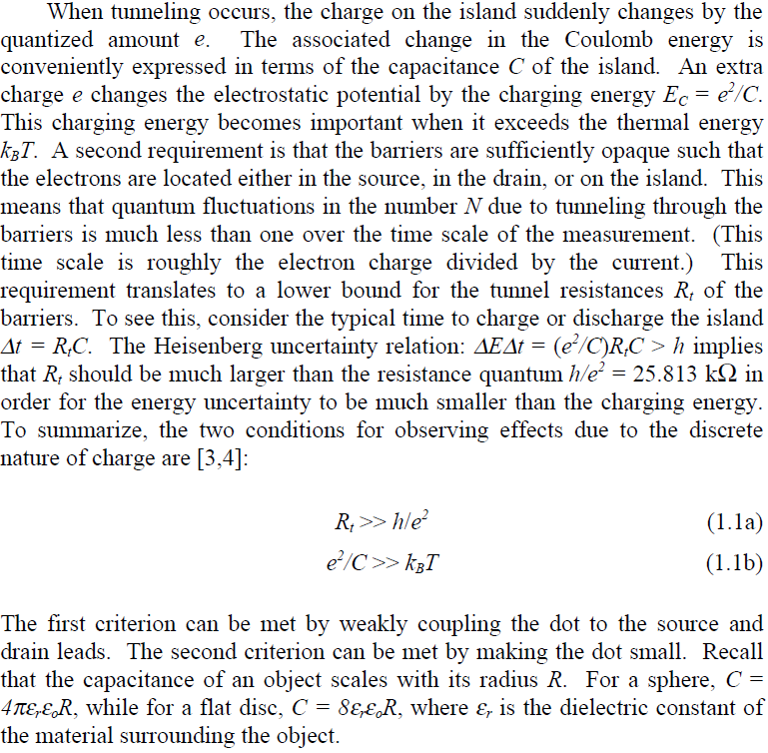

Slide 8
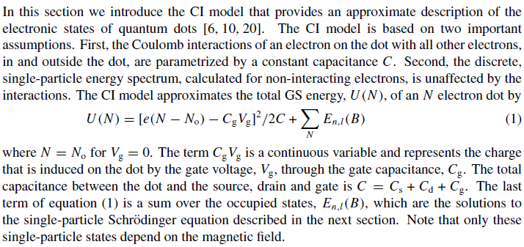
The constant interaction model

Slide 9
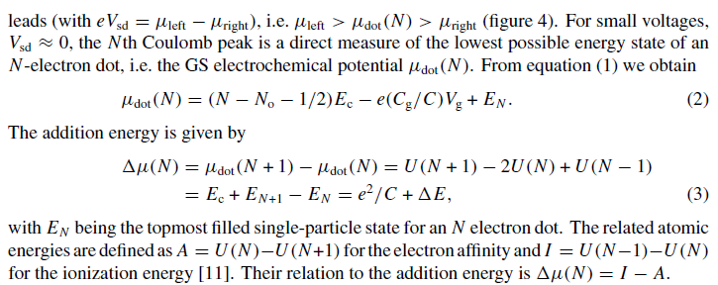

Slide 10
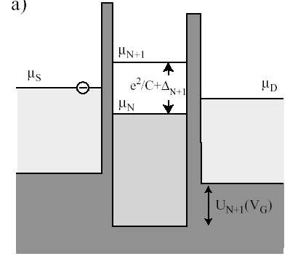
Constant Interaction model
Energetic window depending on L
Constant Interaction model
(C indipendent from N)

Slide 11
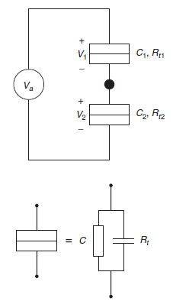
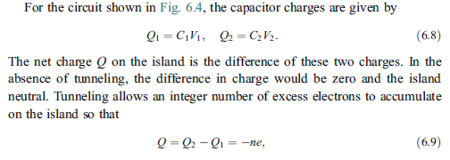
A simplified and intuitive framework

Slide 12
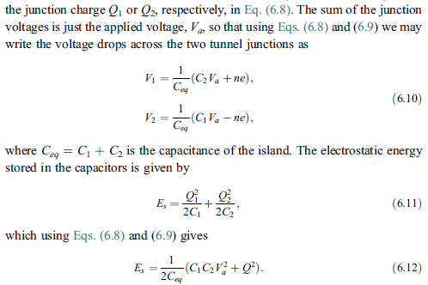
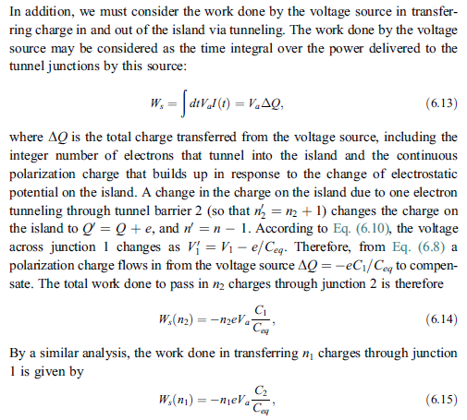

Slide 13
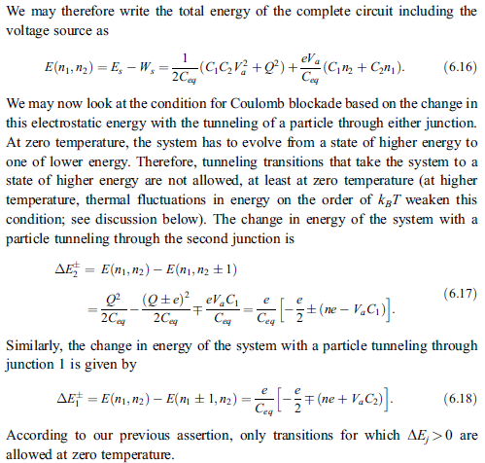
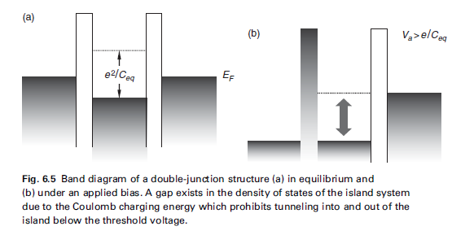
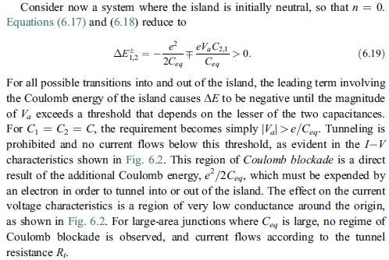
e/C_{eq}

Slide 14
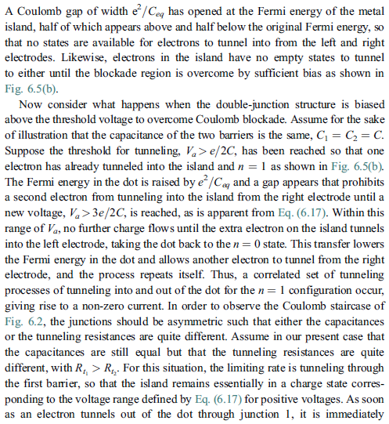
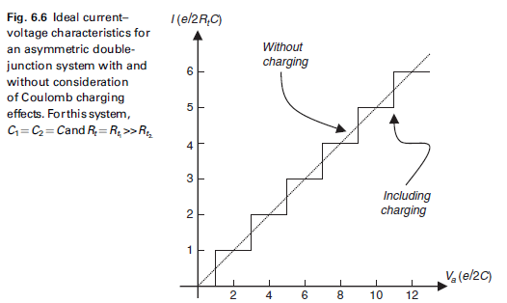
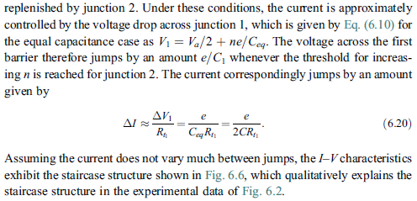
e/2C
3e/2C
5e/2C
R=R₁+R₂
R₁→ T₁
R₂→ T₂

Slide 15
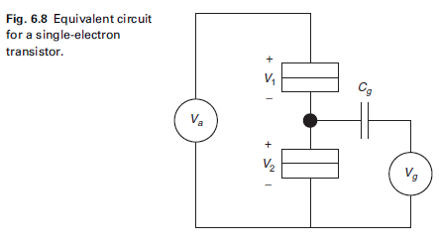
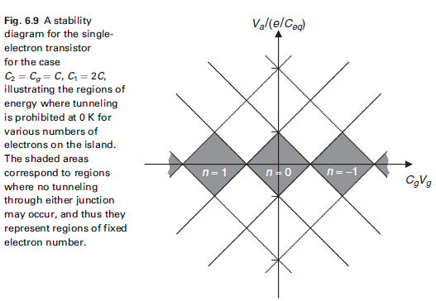

Slide 16
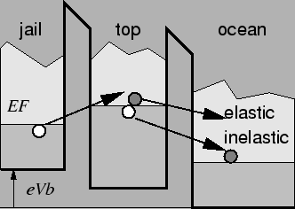
Cotunneling

Slide 17
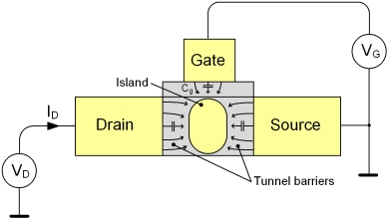
Application 1: Single Electron Transistor and Memory
1
0

Slide 18
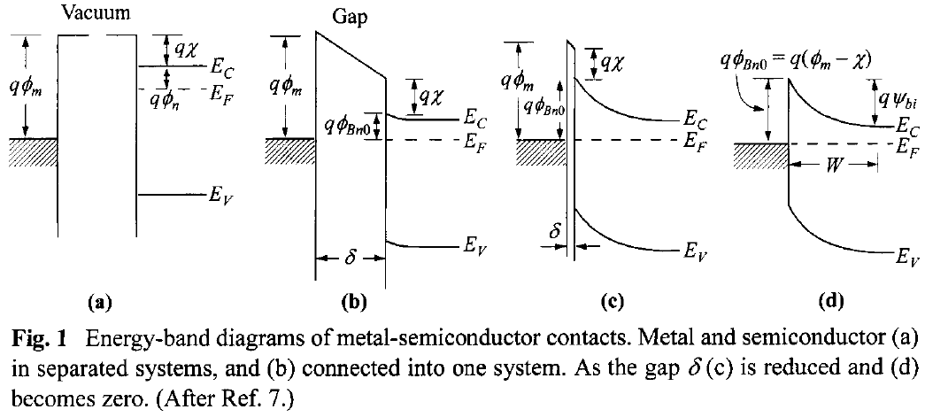
Application 2: NanoSchottky diode

Slide 19
Electronic transport model:
Thermoionic emission
Ballistic transport
Charging Energy (CI)
AFM tip
Au cluster:
3D quantum box
AFM tip
6H-SiC
6H-SiC
6H-SiC
R_{contact}
E_{V}
E_{vacuum}
Φ_{B0}=Φ_{m}-χ_{s}
E_{V}
E_{V}
Φ_{m}(Au)=5.2 eV
χ_{s}(6H-siC)=3.3eV
χ_{s}
Φ_{B0}=1.9 eV
E_{CBmax}
χ_{s}
E_{CBmax}
Φ_{m}
e⁻
Φ_{B}
E_{CBmax}
E_{V}
e⁻
E_{CB}
μ(N+1)
E_{CB}
Thermoionic emission of e⁻ from substrate to nanocluster
e⁻
χ_{s}
Thermoionic emission of e⁻ from substrate to nanocluster
e⁻
Δμ
Φ_{B0}
E_{F}=μ(N)
E_{CB}
Φ_{B}(R)= Φ_{B0} –Δμ(R)
E_{VB}
E_{VB}
Ballistic transport within the nanocluster
E₂
E_{VB}
E₁
ΔE
Ohmic contact tip-nanocluster
2R

Slide 20
1.85 eV SBH of the macroscopic contact Au/6H-SiC
Size Effect:
How a bulk (macroscopic) property derives from the microscopic one

