Slide 1
Lesson 5, Part 1:
Electric field induced transport in nanostructures

Slide 2
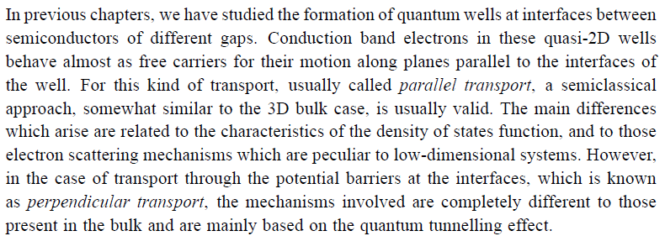
Parallel and perpendicular transport

Slide 3
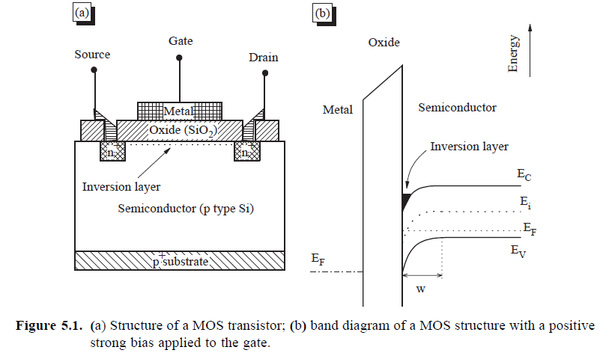
parallel
Perpend.

Slide 4
Parallel Transport
Perpendicular Transport
V
V

Slide 5
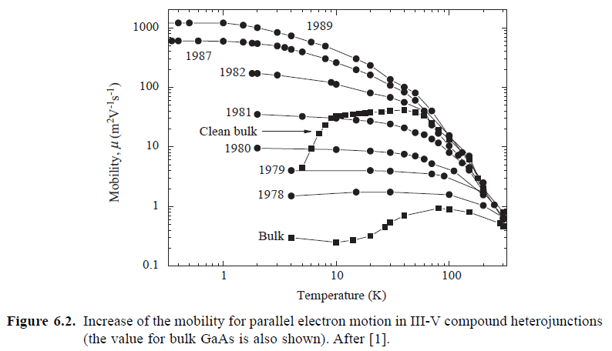
A) Parallel transport: Similar to 3D transport apart from density of states and more important scattering mechanisms
- Electron scattering mechanisms
I) Electron-phonon scattering
II) Impurity scattering
III) Surface roughness scattering
IV) Intersubband scattering

Slide 6
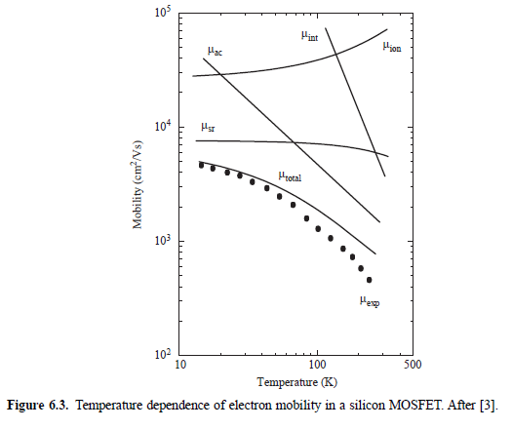

Slide 7
B) Perpendicular transport

Slide 8
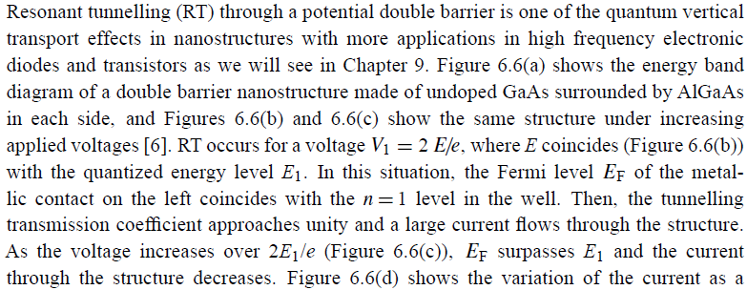
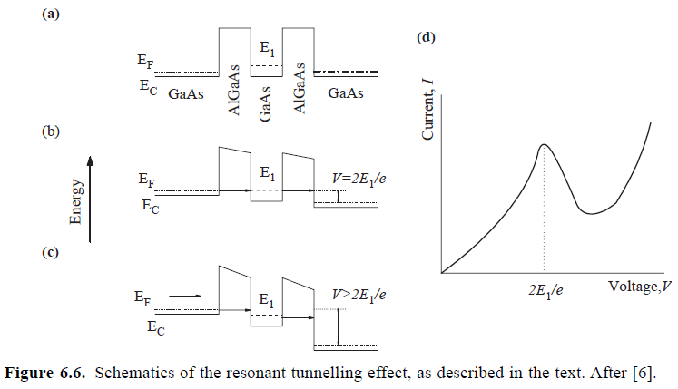
- Resonant tunneling
Differential negative resistance
R=dV/dI<0

Slide 9
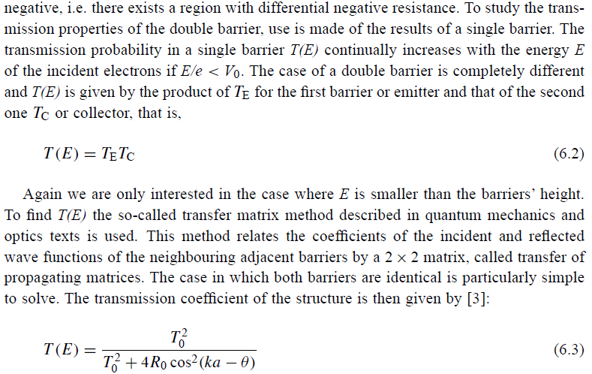

Slide 10
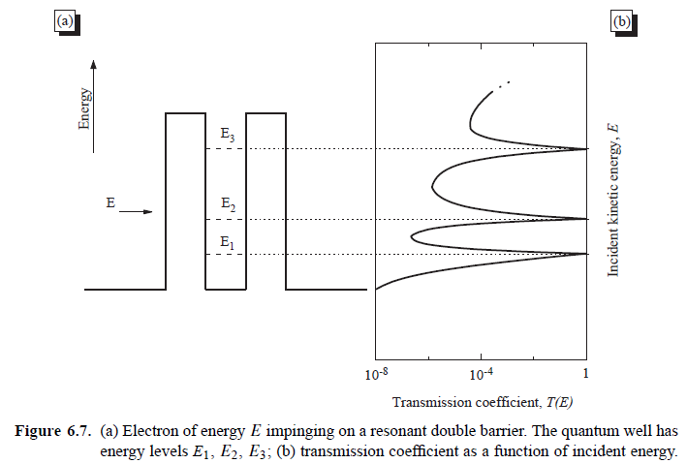

Slide 11
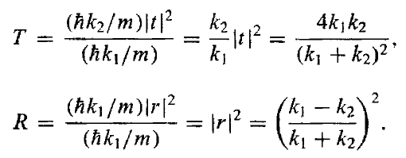
Transfer matrix method (tunnelling transport)

Slide 12
Transmission matrix

Slide 13
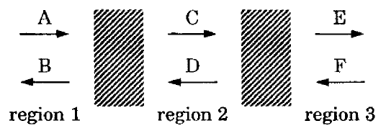
T₁
T₂
T₃
T_{N}
T_{tot}=T_{N} T_{N-1}……T₁

Slide 14
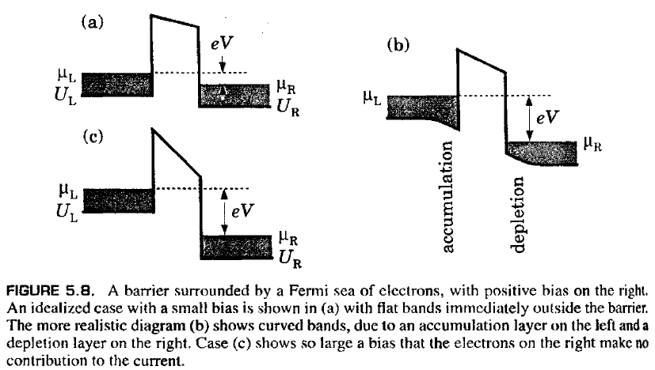
- Electric field effects in superlattices

Slide 15
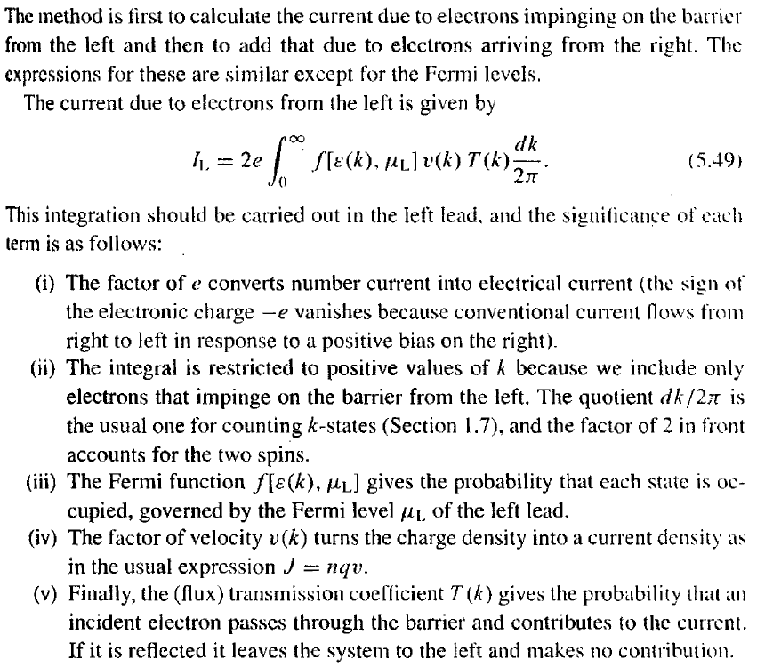
1D current

Slide 16
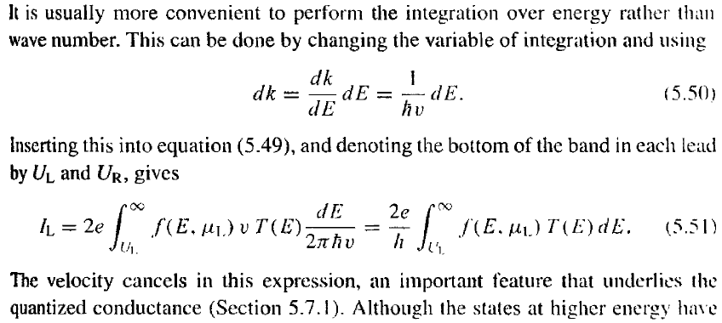

Slide 17
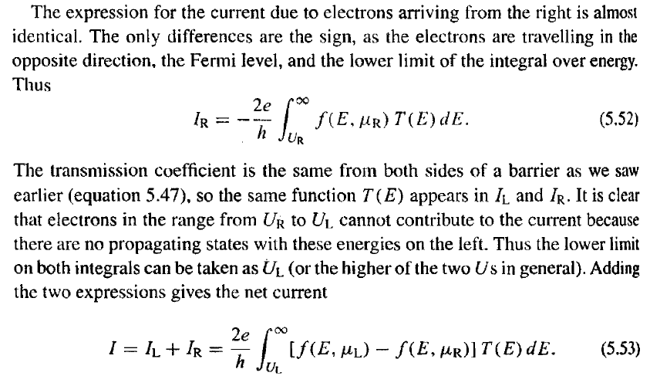
Modified Ohm’s law?

Slide 18
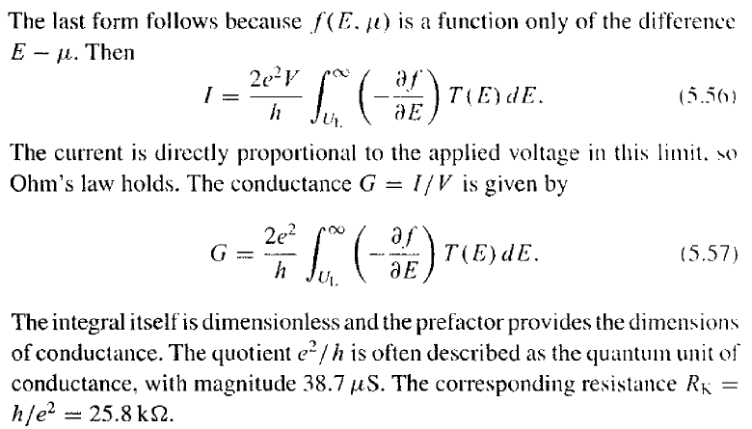
a)

Slide 19
b)
A particular case of the Landauer formula

