Slide 1
Lesson 4:
The physics of low-dimensional semiconductors

Slide 2
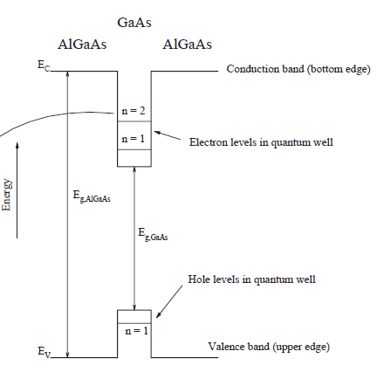
A) Basic properties of 2D semiconductor nanostructures
Quantum well for electrons
Heterostructure
Thin film of a pure or composed material
Common physics

Slide 3
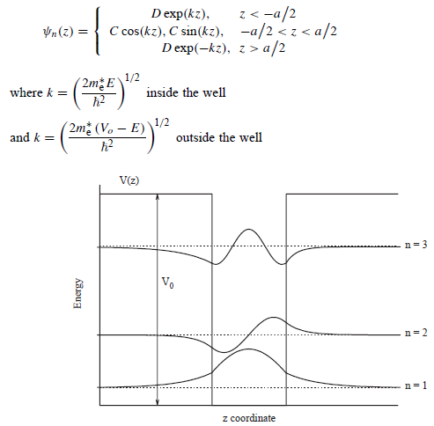

Slide 4
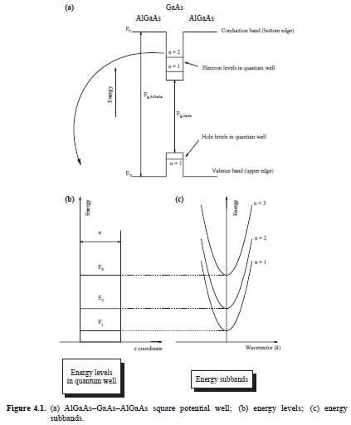
Heterostructure (MBE)
AlGaAs
GaAs
AlGaAs
- Interband processes
- Intraband processes
E(z) engineering (modulation)
Band Engineering
Thickness Engineering

Slide 5
Superlattice
Electronic transport???

Slide 6
Electric Field Applied
Or
Magnetic Field Applied
V
Electronic transport occurs determined by:
A new band diagram (modified by the electric or magnetic field)
Electronic density of states
Tunnelling phenomena
Temperature
Electroniuc coupling
Scattering phenomena

Slide 7
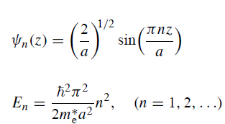
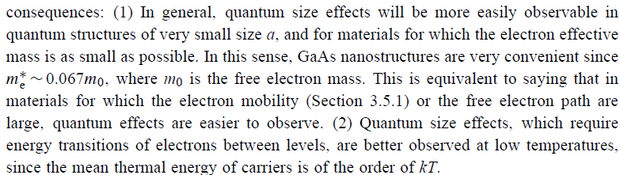
kT
a<<l_{e}
kT<<ΔE

Slide 8
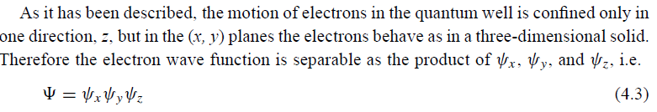
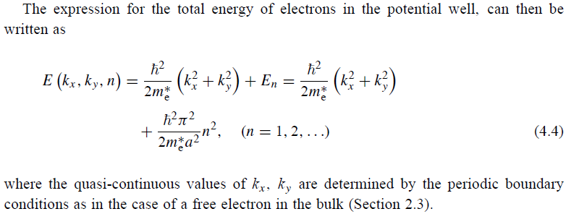

Slide 9
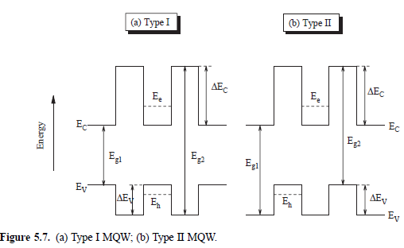
Interband Transitions

Slide 10
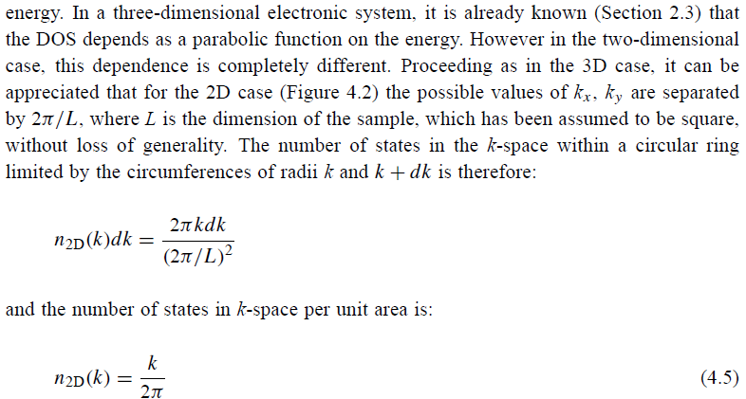
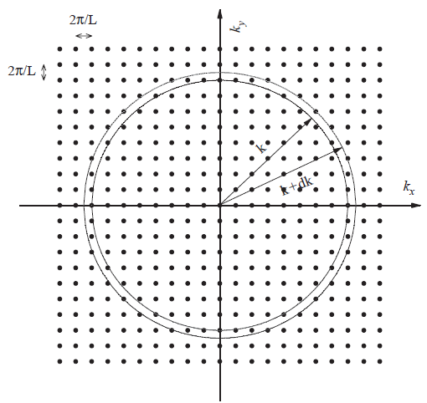
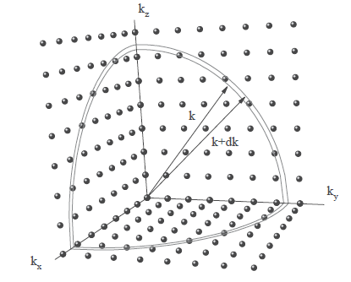
Density of electronic states in a quantum well
3D
2D

Slide 11
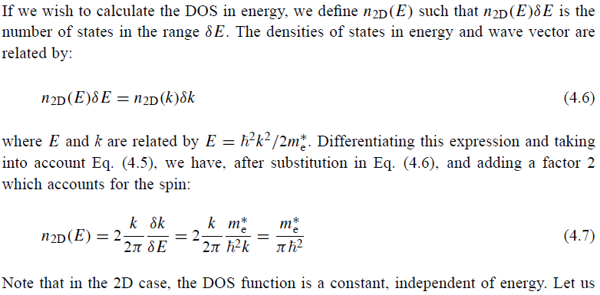
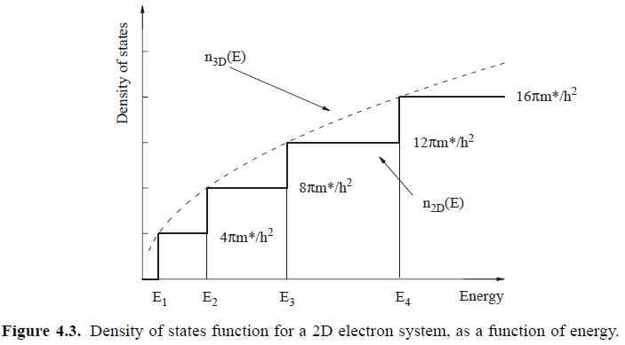

Slide 12
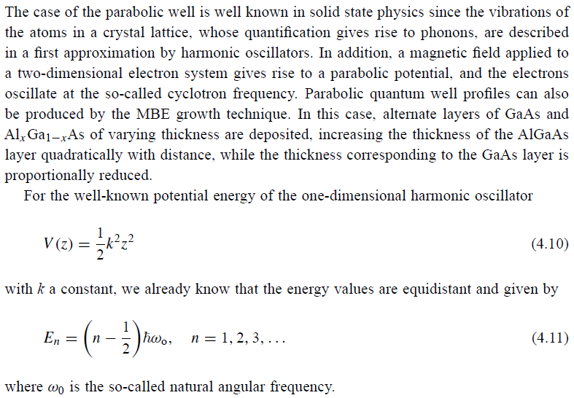
A1) Parabolic and triangular quantum wells
- Parabolic well

Slide 13
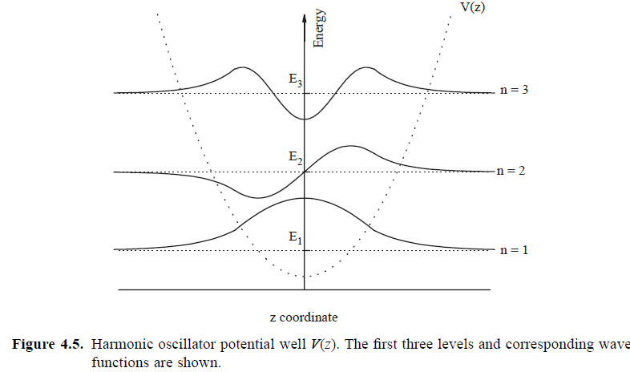

Slide 14
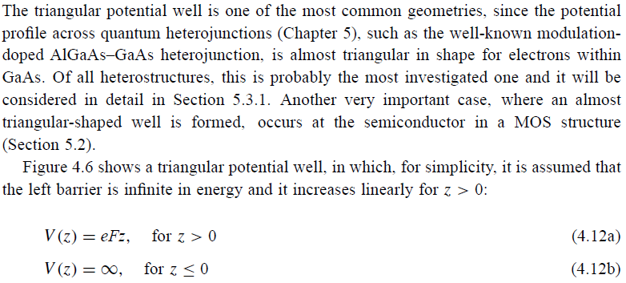
- Triangular well

Slide 15
V

Slide 16
V=0
V≠0

Slide 17
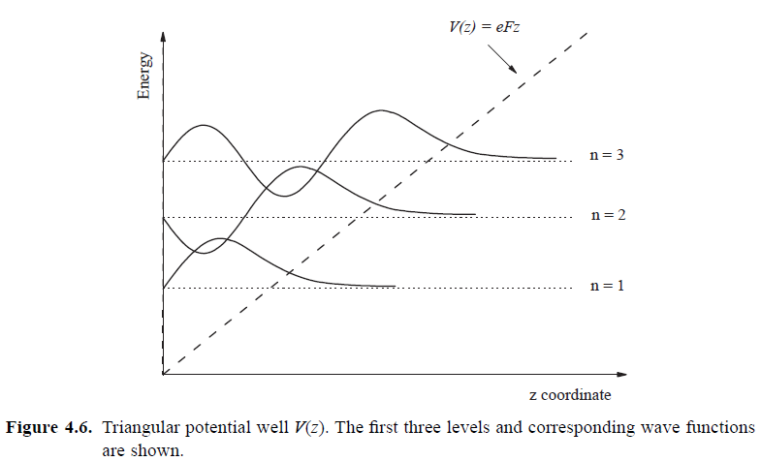


Slide 18
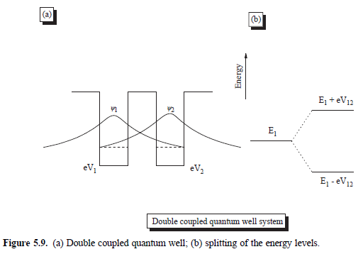
A.2) Superlattices

Slide 19

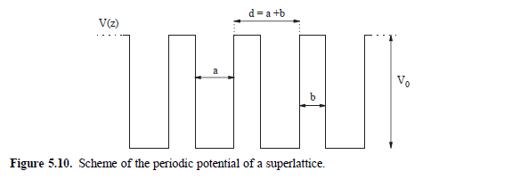
- Kronig-Penney model of a superlattices

Slide 20
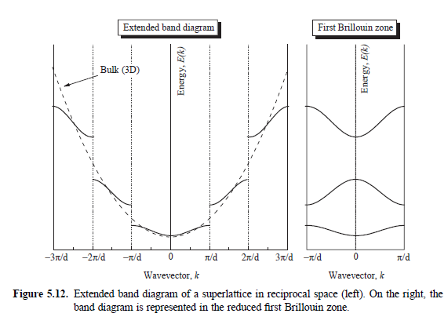
Minigaps
Minibands

Slide 21
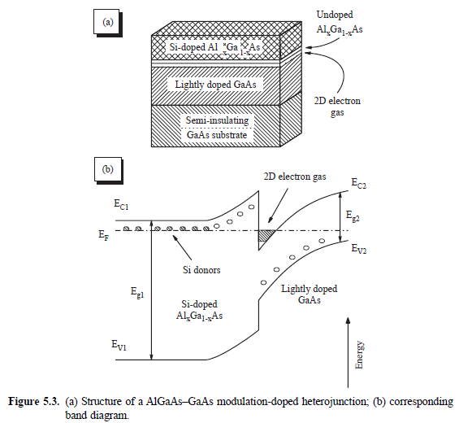
A3) Modulation-doped heterojunctions

Slide 22
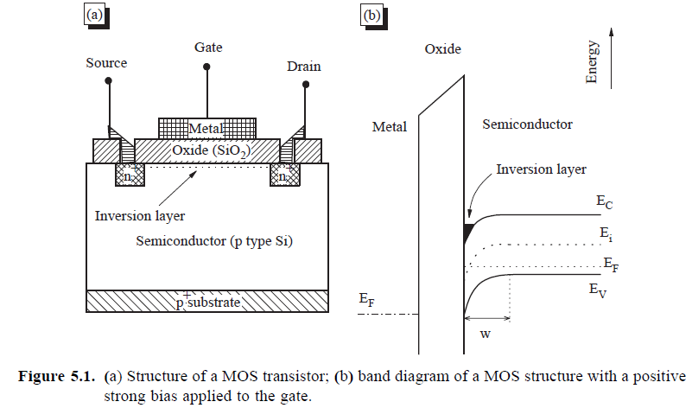
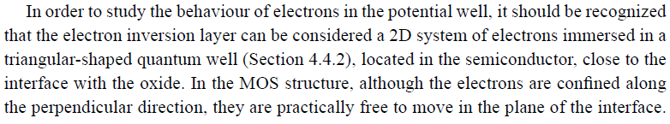
A4) MOSFET structures
2D Electron Gas

Slide 23
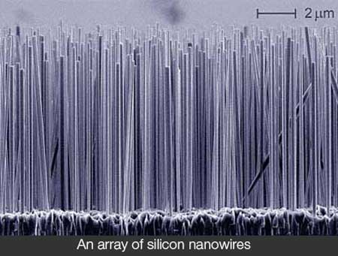
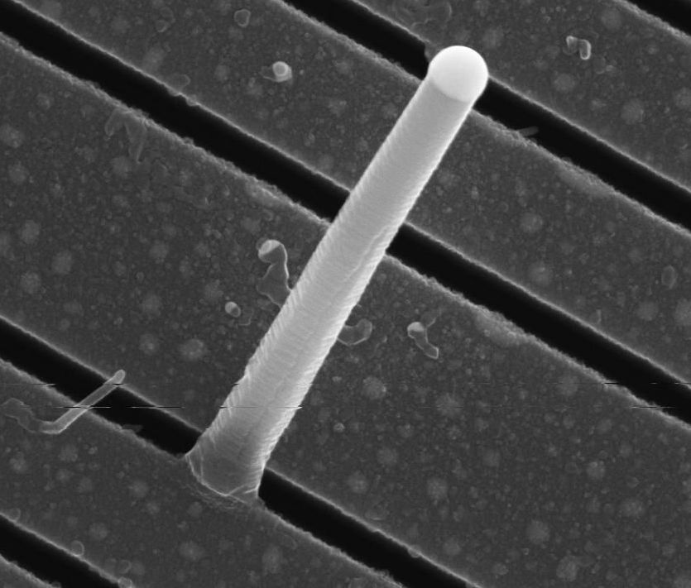
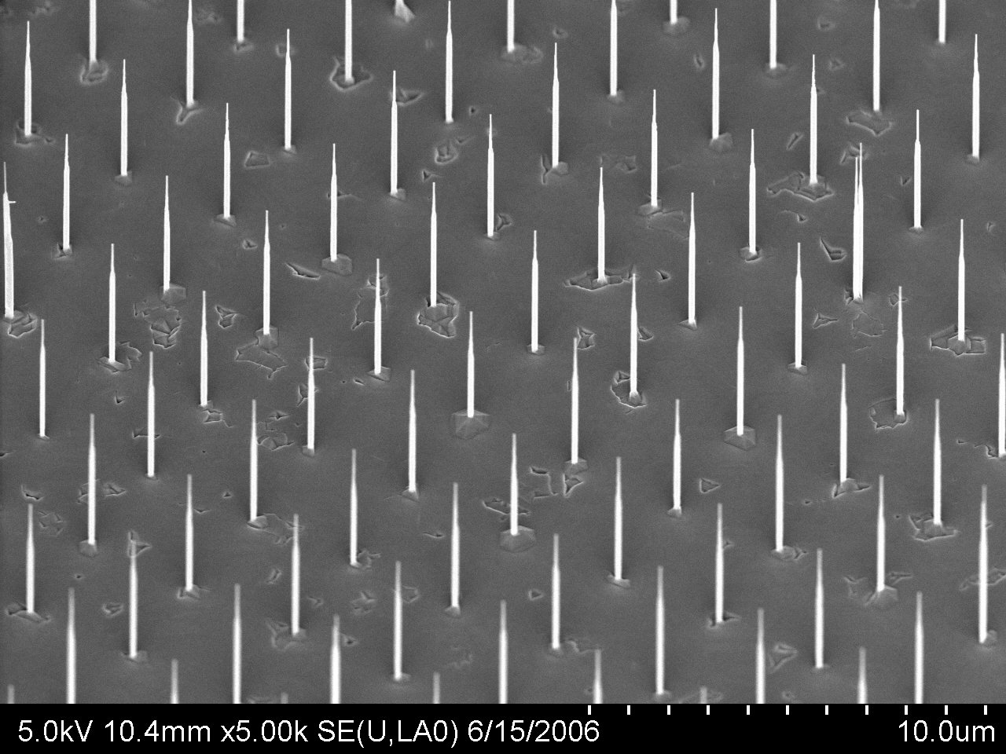
B) Quantum wires (1D semiconductor nanostructures)
C Nanotubes
Si, Ge nanowires

Slide 24
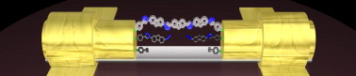
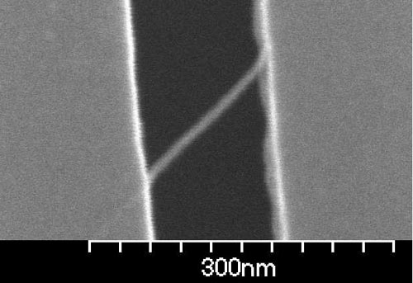
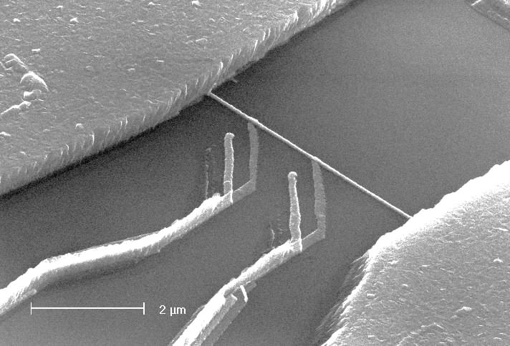
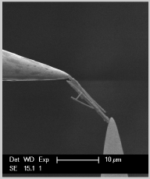
V
Electronic transport occurs determined by:
A new band diagram (modified by the electric or magnetic field)
Electronic density of states
Tunnelling phenomena
Temperature
Electroniuc coupling
Scattering phenomena

Slide 25
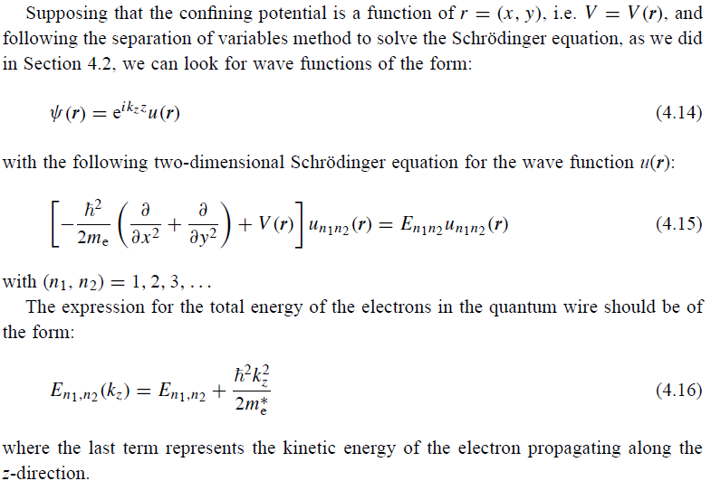

Slide 26
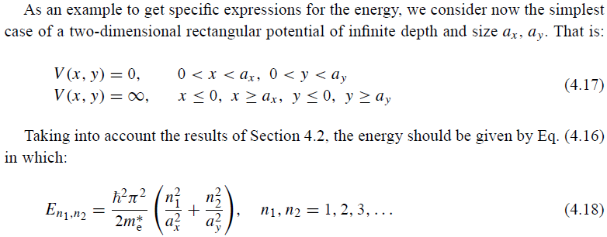

Slide 27
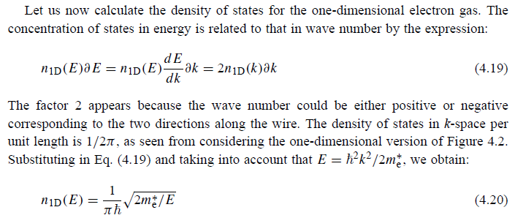
Density of electronic states in a quantum wire

Slide 28
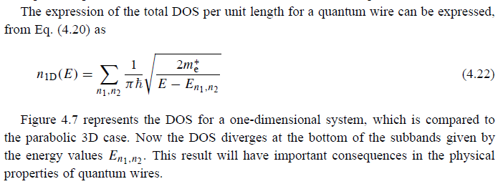
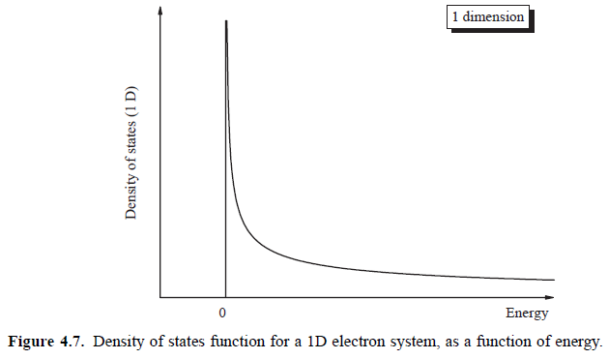

Slide 29

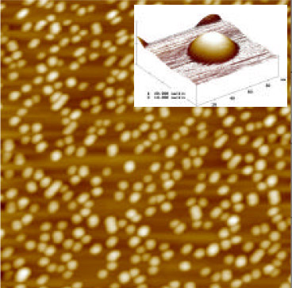
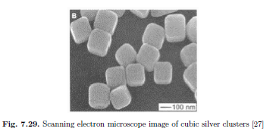
C) Quantum dots (0D semiconductor nanostructures)

Slide 30
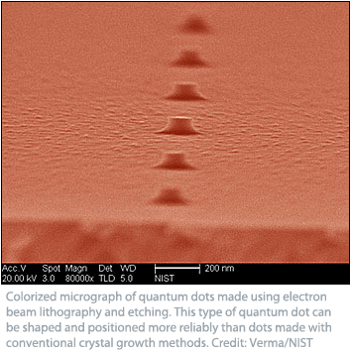
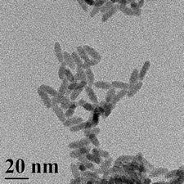
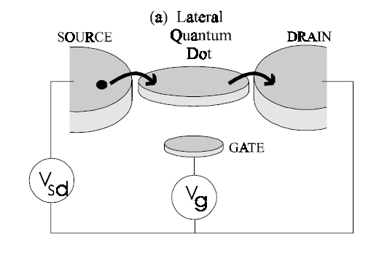
Current???

Slide 31
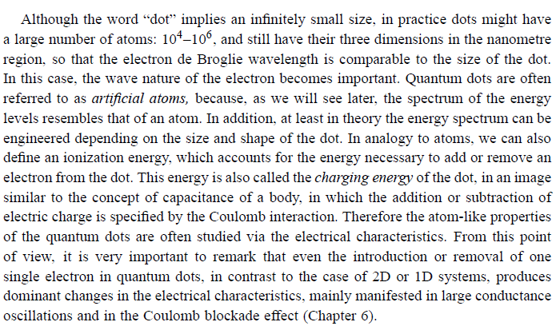
Charging energy (ionization energy) E_{C} (e²/C) and single electron effects

Slide 32
3D: ΔE>>E_{C}
2D: ΔE>>E_{C}
1D: ΔE>>E_{C}
0D: ΔE~E_{C}
ΔE
E_{C}
kT
3D, 2D, 1D
0D
ΔE
E_{C}
ΔE
E_{C}
kT
kT

Slide 33
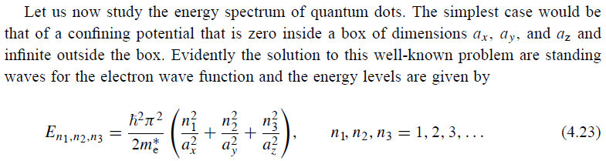
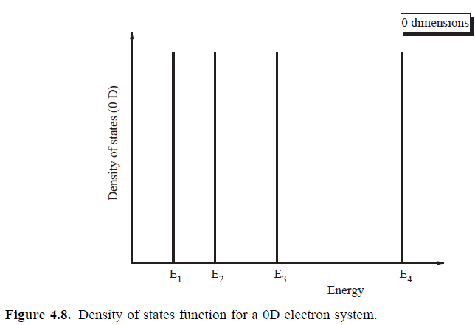
Density of electronic states in a quantum dots

