Slide 1
Lesson 3:
Review of semiconductor physics

Slide 2
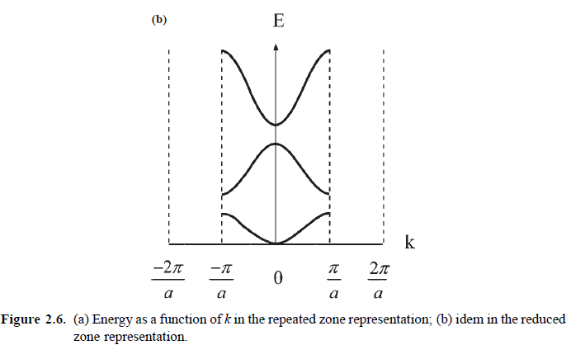
A) Energy bands in typical semiconductors
Semiconductors: E_{G}~0.7-3 eV

Slide 3
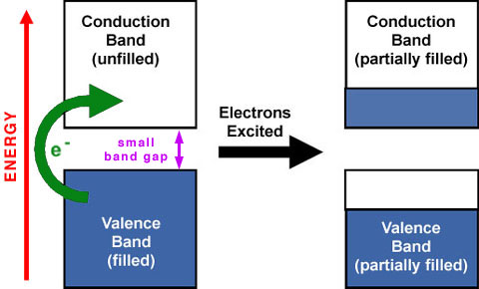
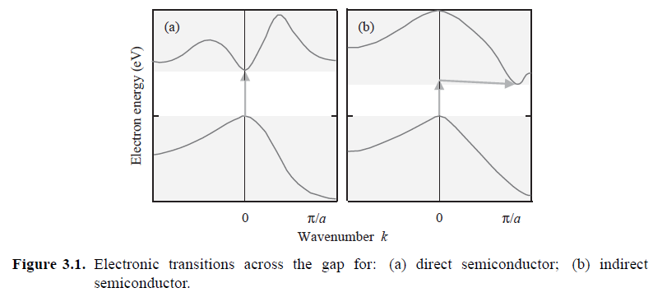

Slide 4
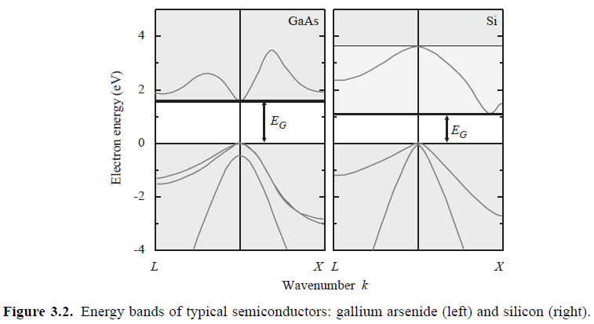
GaAs: 1.43 eV
Si: 1.1 eV
Ge: 0.67 eV

Slide 5
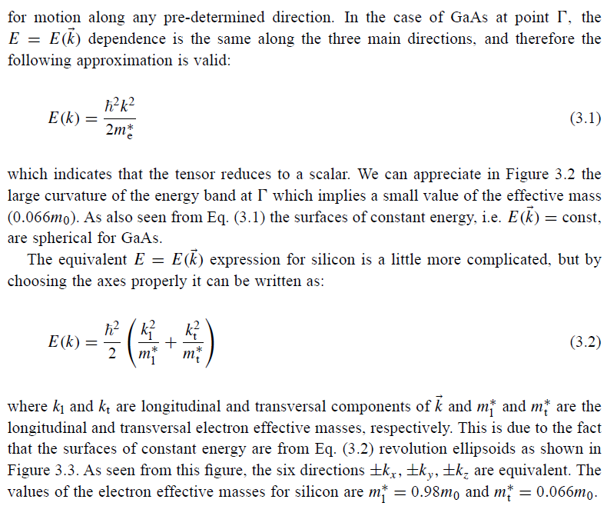

Slide 6
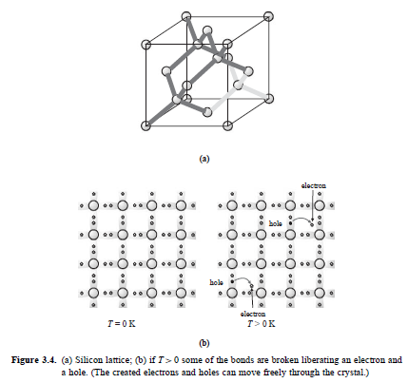
B) Intrinsic and extrinsic semiconductors
Thermal-induced or photon-induced transition

Slide 7
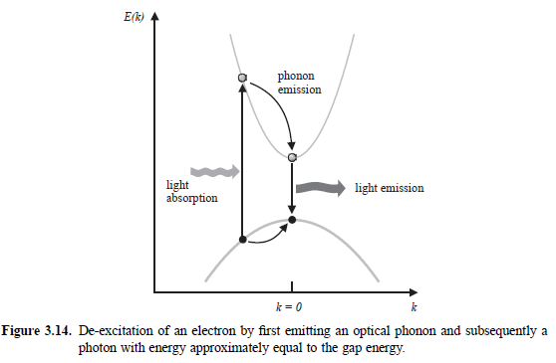

Slide 8
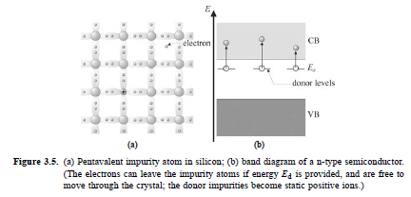
~0.05 eV

Slide 9
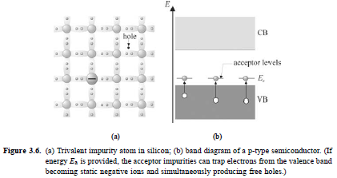
~0.05 eV

Slide 10
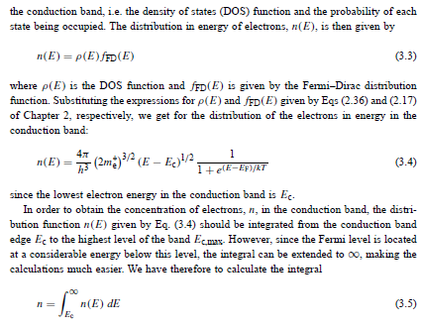
C) Electronic and hole concentrations in semiconductors

Slide 11
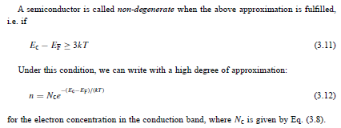

Slide 12
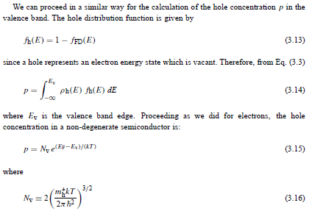

Slide 13
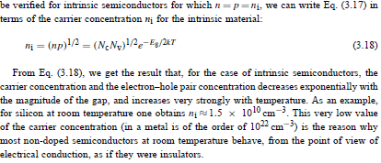

Slide 14
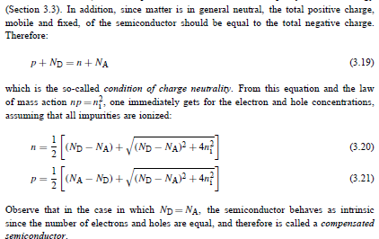

Slide 15
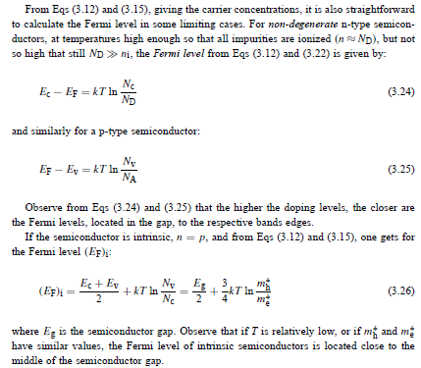
Intrinsic
BC
BV
n-type
BC
BV
p-type
BC
BV

Slide 16
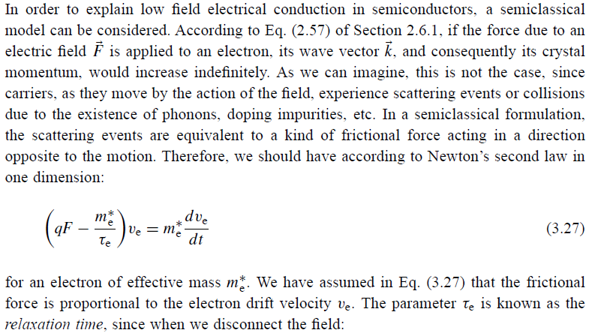
D) Transport in semiconductors
- Electric field transport; Mobility

Slide 17
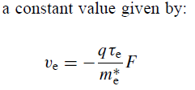
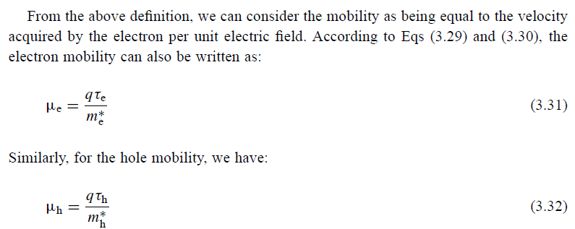

Slide 18
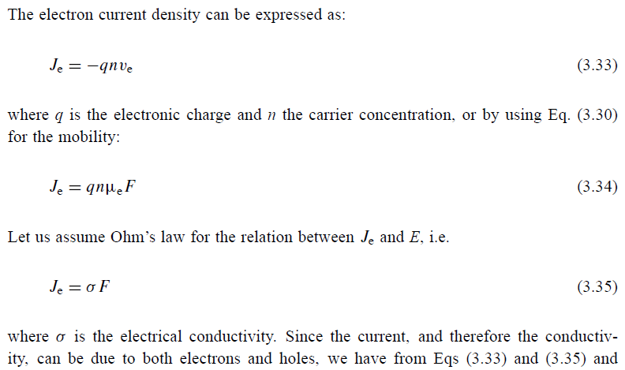

Slide 19
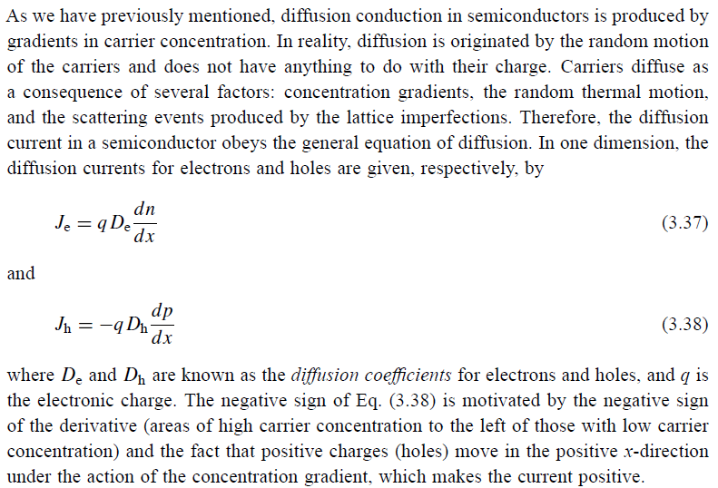
- Conduction by diffusion

Slide 20
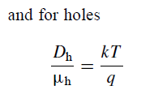

Slide 21
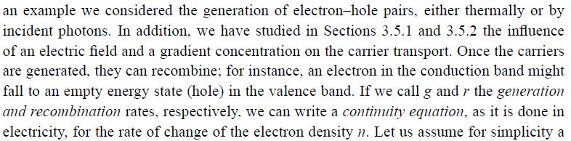
- Continuity equation. Carrier lifetime and diffusion length
p-type
n-type

Slide 22
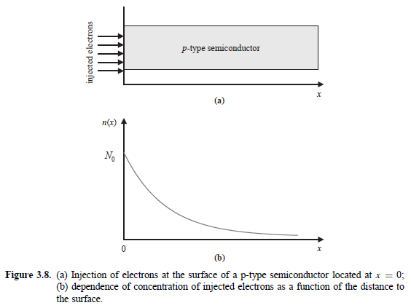

Slide 23
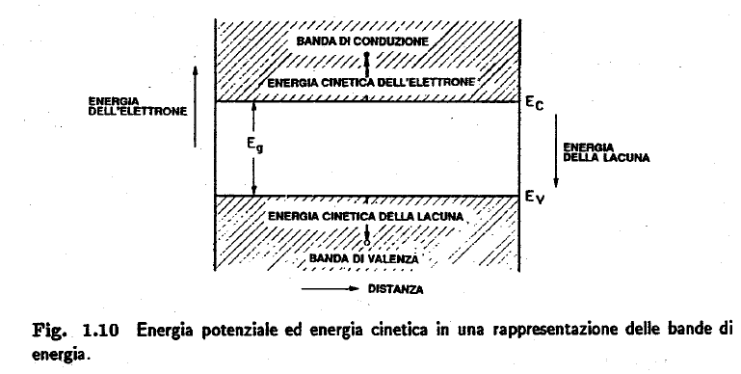
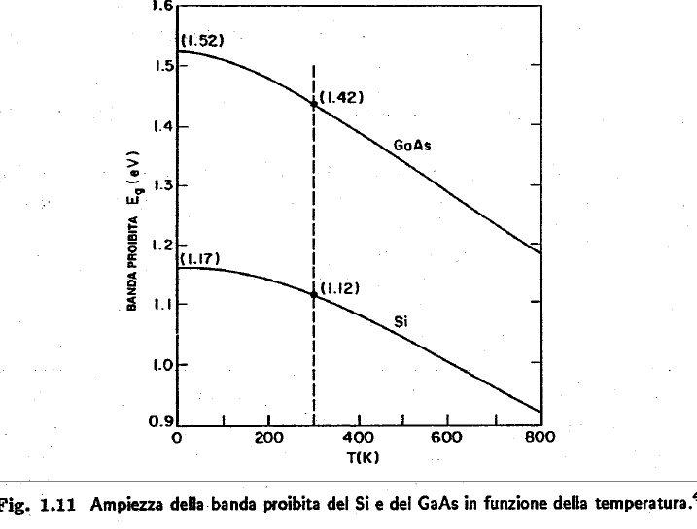
Some experimental observations
1

Slide 24
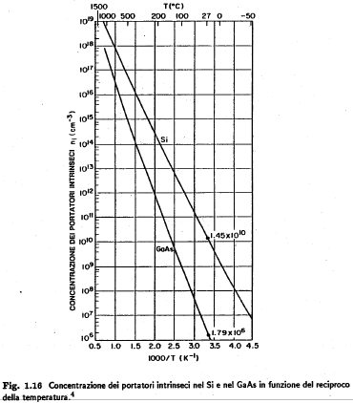
2

Slide 25
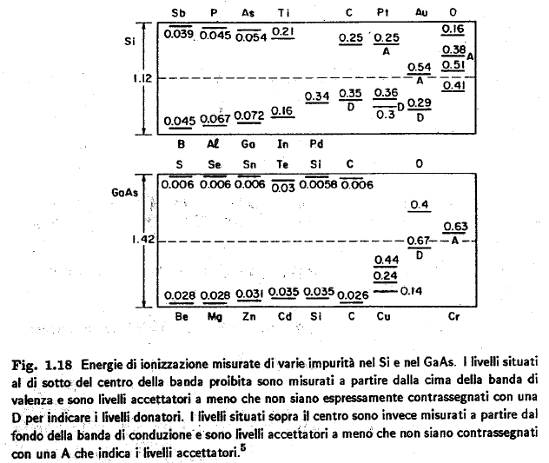
3

Slide 26
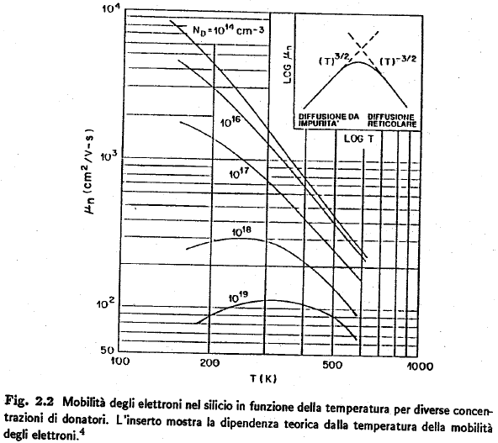
4

Slide 27
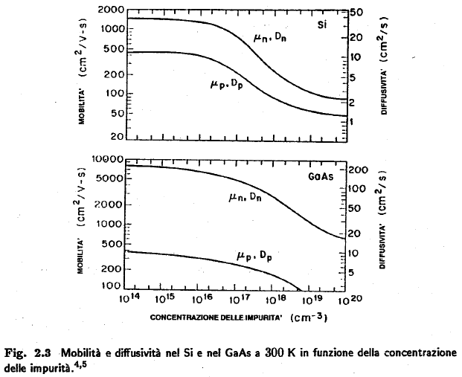
5

Slide 28
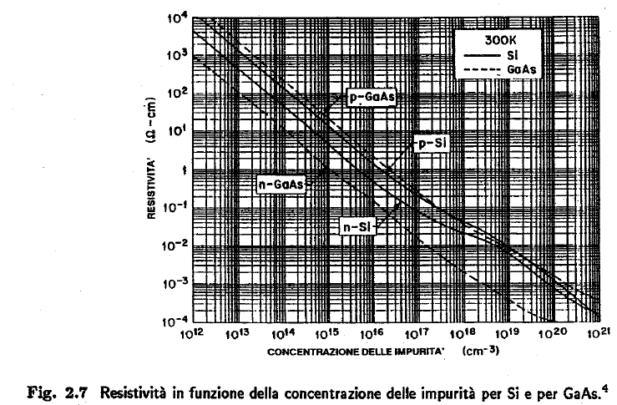
6

