Slide 1
Lesson 1:
Mesoscopic physics and nanotechnology

Slide 2
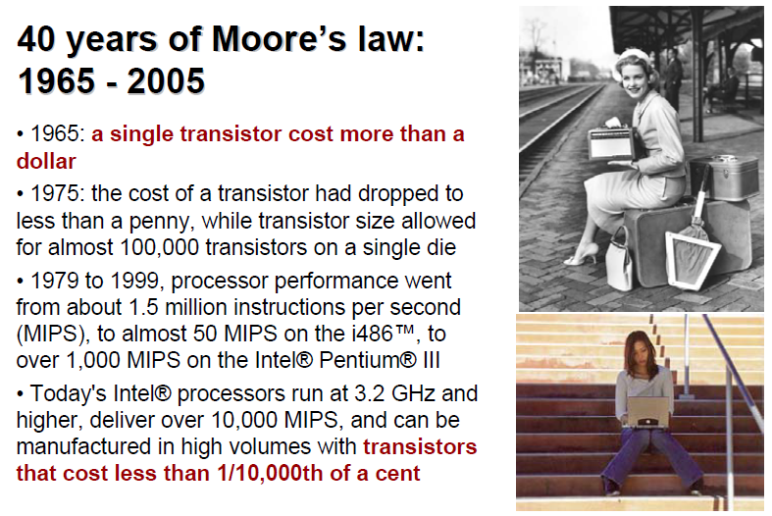

Slide 3
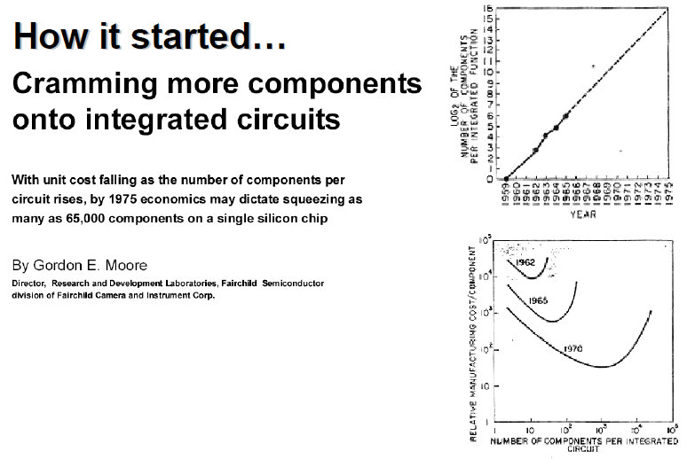

Slide 4
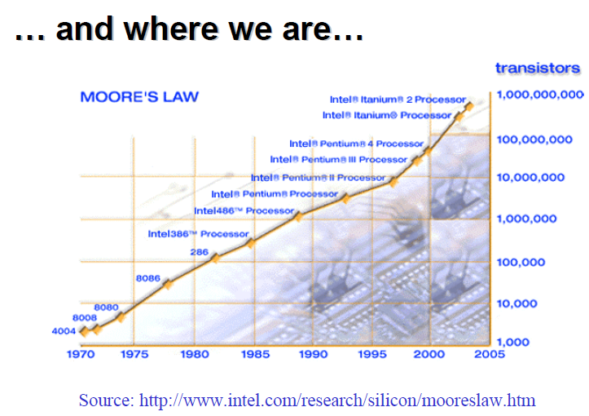

Slide 5
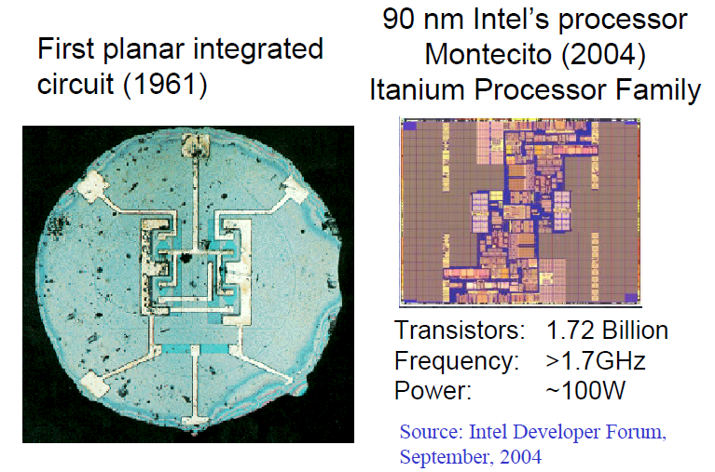

Slide 6
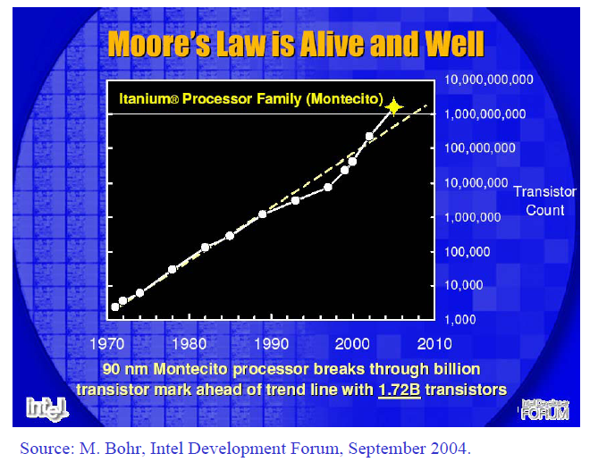

Slide 7
Average Cost per Transistor vs Time
100 n$

Slide 8
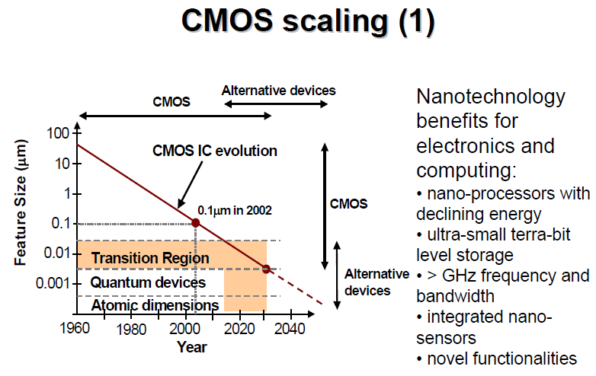

Slide 9
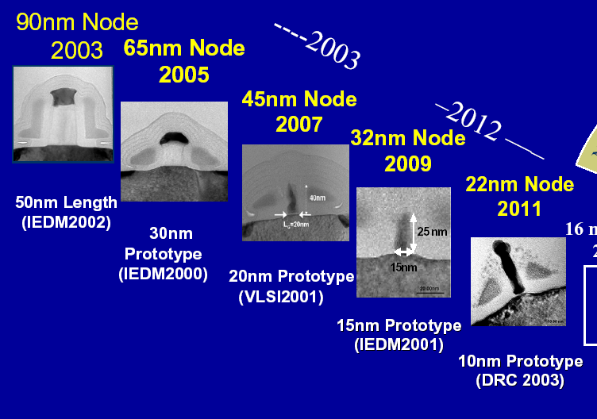

MOSFET Feasibility

Slide 10
Physical limits
… undesired effects impact
severely MOSFET performances
Short
Channel
Statistical
Fluctuations
Direct
Tunnelling

Slide 11
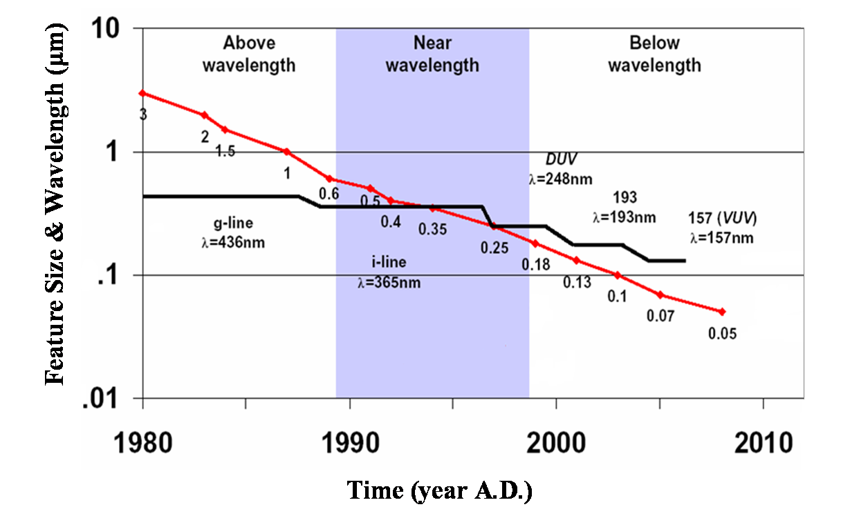
Technological Limit
Nano – Era

Slide 12
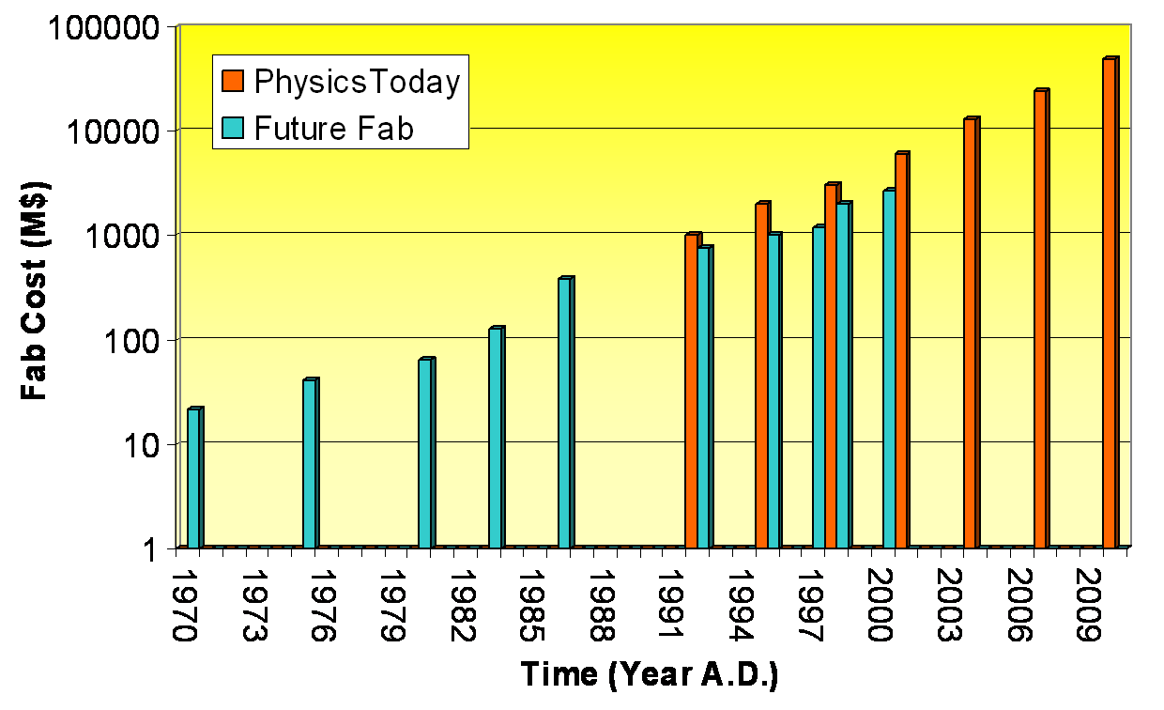
Economic Limit

Slide 13
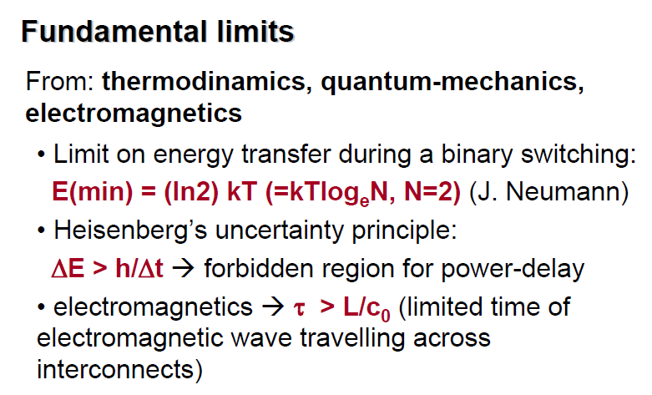

Slide 14
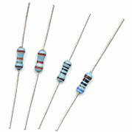
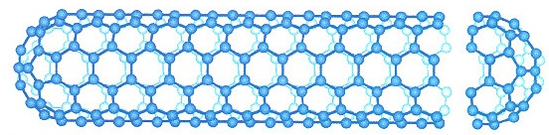
Conductance of one-dimensional ballistic wire is quantized:
With perfect contacts:
G = ^{current} / voltage
= 2*2e²/h
I
V
(two subbands in NT)
Quantum of resistance:
h/e² = 25 kOhm

Slide 15

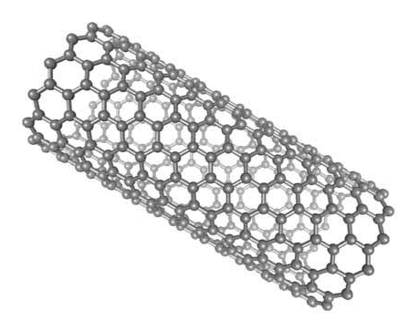
Mesoscopic regime
Nanoscale electrical transport
Electrons
Charge -e
Single-electron effects
Wave function
Size quantization
Mesoscopic transport; quantum transport ...
?
nm
μm

Slide 16
Resistance and conductance
Ohm’s first law: V = R . I
Ohm’s second law: R = V / I [Ω]
Bulk materials; resistivity ρ:
R = ρ L / A
Nanoscale systems (coherent transport):
R is a global quantity, cannot be decomposed
into local resistivities (see why later)
Conductance G: G = 1 / R = I / V [unit e²/h]
(Not conductivity σ)
ρ
A
L
R is additive

Slide 17
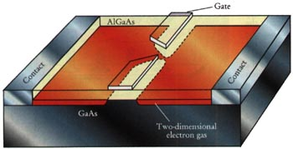
Transport regimes
(simplified)
Length scales: λ_{F} Fermi wavelength
(only electrons close to Fermi level contribute to G)
L_{m} momentum relaxation length (static scatterers)
L_{φ} phase relaxation length (fluctuating scatterers)
L sample length
Ballistic transport, L << L_{m}, L_{φ}
  no scattering, only geometry (eg. QPC)
  when λ_{F}~ L: quantized conductance G~e²/h
Diffusive, L > L_{m}
  scattering, reduced transmission
Localization, L_{m} << L_{φ} << L
  R ~ exp(L) due to quantum interference at low T
Classical (incoherent), L_{φ}, L_{m} << L
  ohmic resistors

Slide 18
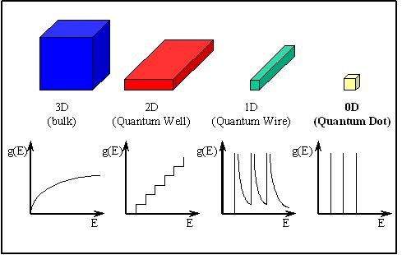
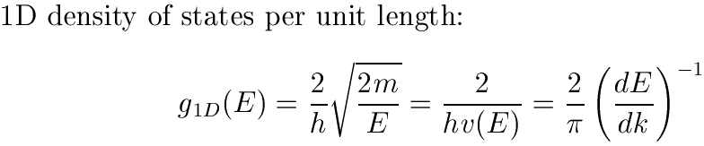

Electronic structure
Density of states (DOS)
1D:
semiconductor
quantum wires
conducting polymers
nanotubes
0D:
atoms
molecules
nanocrystals
metal nanoparticles
quantum dots
short nanotubes

Slide 19
A short digression: Nanostructures and fabrication technologies

Slide 20
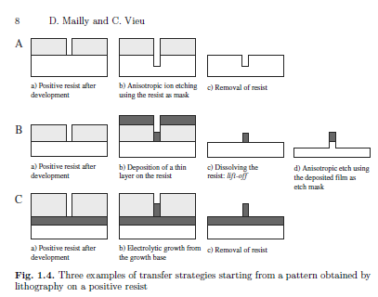
Ideas at the basis of the nanolitography (x-ray litography, electron beam litography. Top-down)

Slide 21
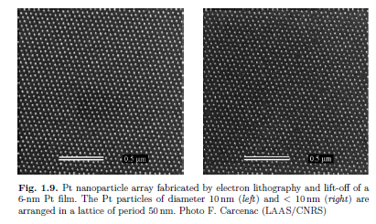
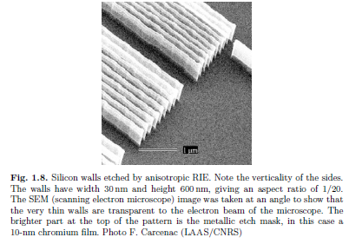
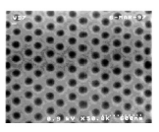
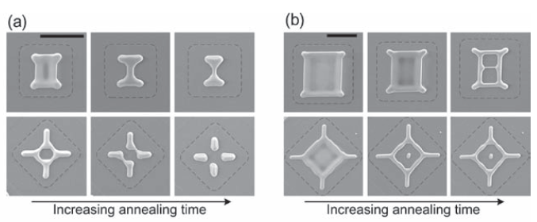
N. B.
Minimum size >20 nm
Spatial order on a large scale

Slide 22
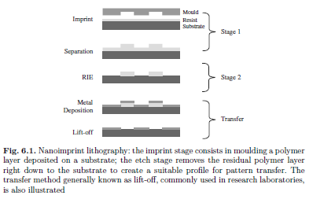
Ideas at the basis of the nanoimprinting litography ( Top-down)

Slide 23
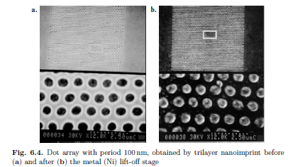
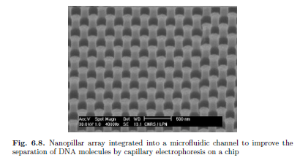

Slide 24
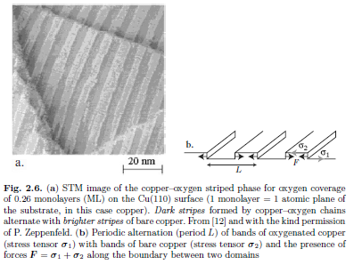
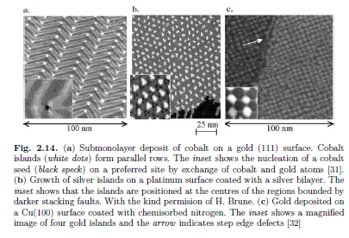
Growth of nano-object on prepatterned surface (Hybrid top-down/bottom-up)

Slide 25
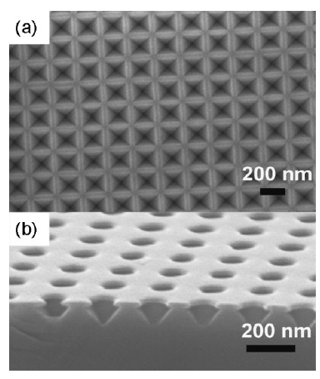
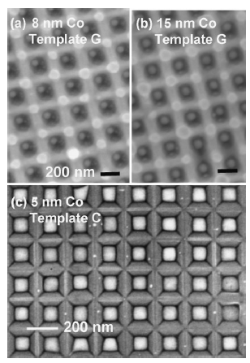
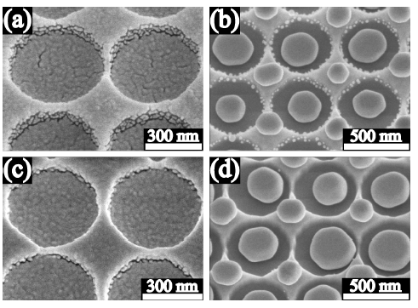
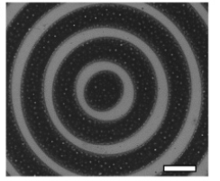
Au

Slide 26
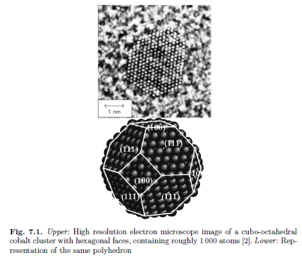
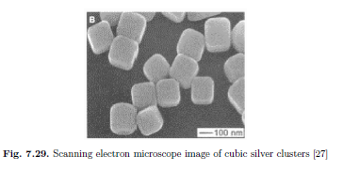
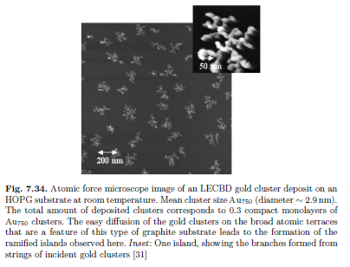
Clusters and colloids ( bottom-up)

Slide 27
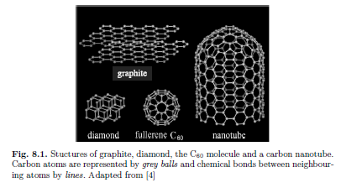
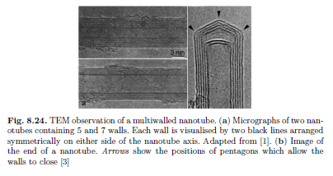
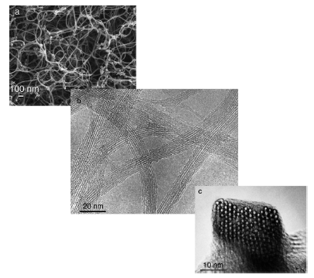
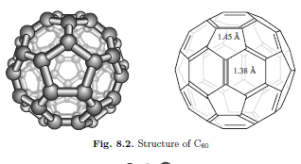
Fullerens and carbon nanotubes ( bottom-up)

Slide 28
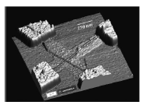

Slide 29
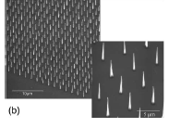
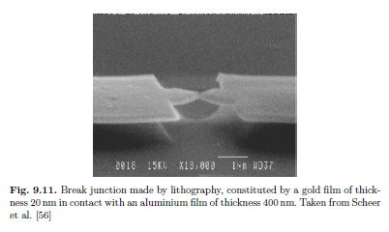
Nanowires ( top-down and bottom-up)

Slide 30
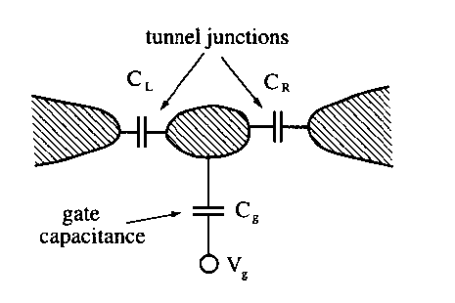
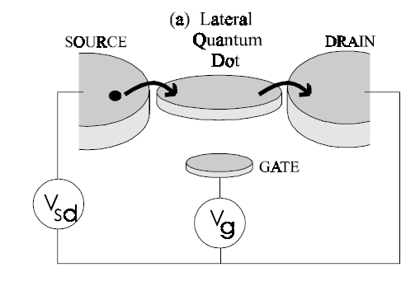
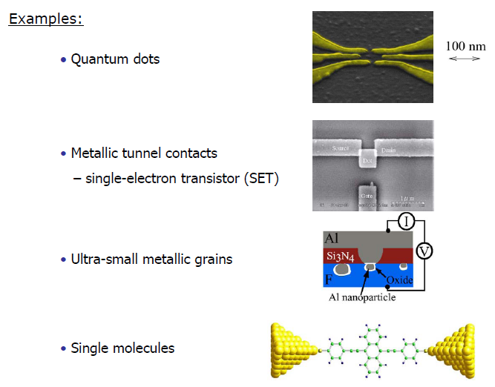

Slide 31
Single nanostructure system
Source
Metallic nanoclusters
Fundamental paramaters:
Material;
Shape;
Size;
Surrounding.
Drain

Slide 32
Nanostructures array systems: artificial atoms solids
Fundamental paramaters:
Material;
Shape;
Size;
Surrounding;
Electronic coupling;
Structural disorder.
Electronic coupling (wavefunctions overlapping, capacitive coupling, electron-electron interactions
Structural disorder: site-to-site energy fluctuatiuons

